Slide 1
Relative Story Pointing Basics
Jason Knight
4/29/2019
Notes:
Work estimates of time in software are almost never precisely predictable
It is more often valuable to develop software inspecting and adapting rather than predicting and planning

Slide 2
Ass-umptions
In software, time estimates are almost never reliable.
Software isn’t valuable unless someone is using it.
Notes:
These are two assumptions I hold that factor prominently in the reasoning that follows.

Slide 3
What is your job?
Deliver valuable solutions to customers’ problems
Notes:
What is your job as a software developer? I understand that there are lots of responsibilities and activities we each choose to busy ourselves with. What is the central point of it all though?

Slide 4



Why estimate?
Optimize for local concerns…BOOO!
Notes:
Bad Reasons:
Be made a scapegoat when things go sideways
Measure individual performance
Predict the future for our bosses

Slide 5

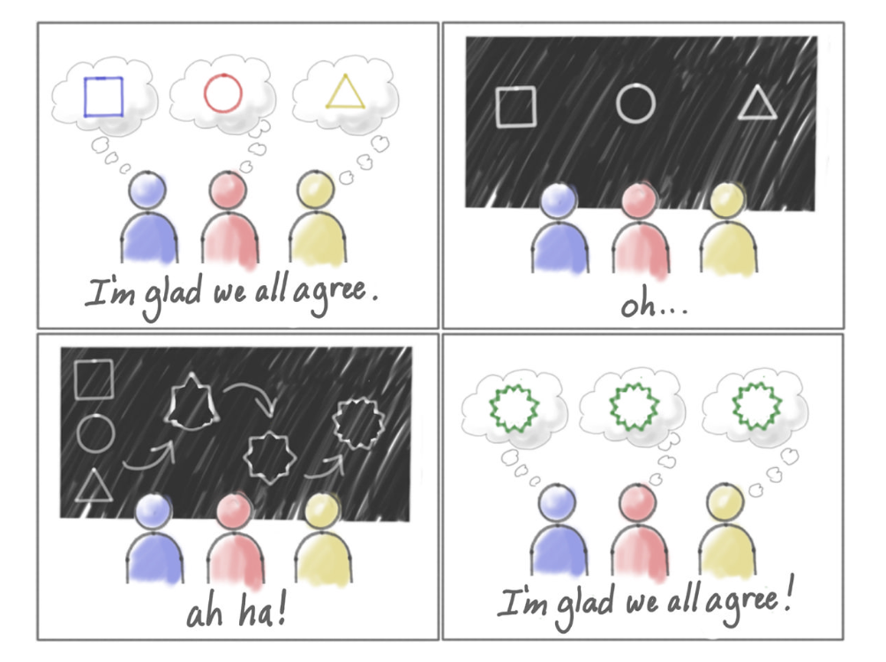
Why estimate?
Validate a strategic choice
Notes:
Good Reasons:
We want to build common understanding of the work to be done soon™
We want to forecast our ability to deliver work
Validate strategic choice

Slide 6
What is a Story Point?
A unit of measure for expressing an estimate of the overall effort that will be required to fully implement a product backlog item or any other piece of work.

Slide 7
Yeah, but what goes into a Story Point?
The amount of work to do
The complexity of the work
Any risk or uncertainty in doing the work

Slide 8


Amount of Work
Construct a Single Shirt
Construct 100 Shirts
More work means higher estimate
Notes:
As amount of work increases, estimate goes up. With a lot of work, you might find ways to do each bit faster. Not necessarily a linear progression.

Slide 9

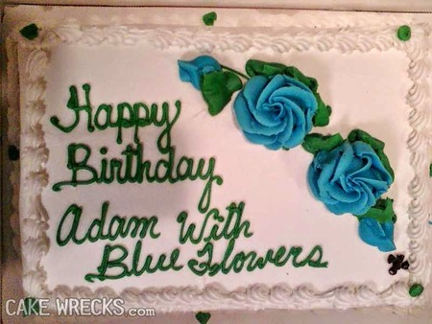
Risk and Uncertainty
Risk
Uncertainty
Minimizing risk and clarifying work means higher estimate
Notes:
Risky work means you will proceed with more caution. Effort increases.
When work is uncertain, you will take more time to clarify. Effort increases.

Slide 10
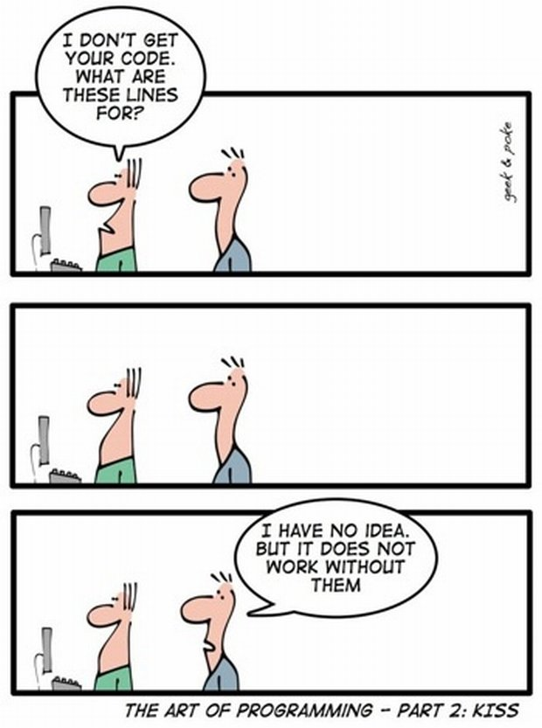
Complexity
More complexity means higher estimates
Notes:
Complex work means more analysis must be performed to understand the effect of changes. Effort increases.

Slide 11

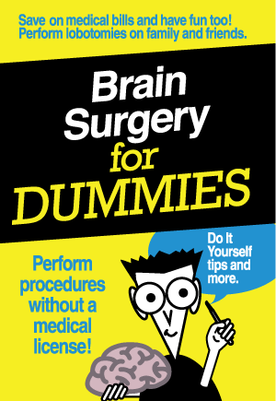
Why not just use complexity?
Complexity is just not enough to describe effort
Notes:
Which is easier. Licking 1,000 stamps or performing simply brain surgery? Presuming they take the same amount of effort, one is simple with high amount of work and the other is complex with a low amount of work.
If there is additional risk or uncertainty to either, this increases effort as well. Maybe you have a rare adhesive allergy or maybe you have low blood pressure or other pre-existing conditions. These should all increase effort as well.

Slide 12
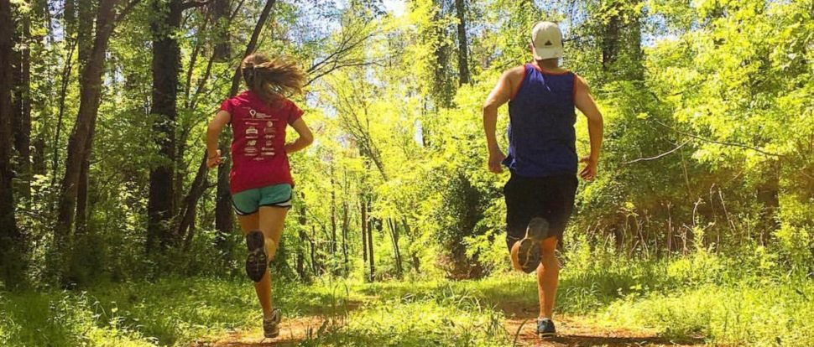
Why not estimate time?
Effort should not depend on who is doing the work
Notes:
Runner 1 runs trail in 30 minutes. Runner 2 runs it in 60 minutes. How much effort does the trail represent? A compromise of 45 serves neither. What’s the answer?
It’s a 5 mile trail that takes Runner 1 30 minutes AND a 5 mile trail that takes Runner 2 60 minutes. 5 miles is the abstraction that we can agree on. Without that abstraction, we can’t talk about the trail in objective terms and fall prey to subjective arguments and estimates tightly-coupled to who is doing the work. Tightly-coupled work of this nature is less useful to the team since it likely becomes inaccurate if a different teammate decides to take on the work. You might suggest that different teammate should just re-estimate when they take the work. I suppose if that developer loves estimating, then this could be a positive for them personally. I’d argue it is a net drain on the team’s time and attention given the increased information management in product backlog items.
Alternatively, if story points just map to time, wouldn’t it be better to just use time?! Why waste precious hours with an utterly redundant abstraction?

Slide 13

Why not forecast individual velocity?
Collaborative work requires collaborative forecasting
Notes:
Because our work is rarely individual. If the work requires collaboration, individual velocity masks the inherent, collaborative work and leads to:
Unnecessary complexity of forecasts
Inaccurate forecasts
Individual scapegoating
Fractured focus and fractious team dynamics
Increased time and attention paid to backlog management
PBI’s tightly coupled to individual’s estimates i.e what do you do when you take on work for a teammate who had done the estimation?
Story points are instead a measure of the collectively difficulty the focused development team faces to complete the work.

Slide 14
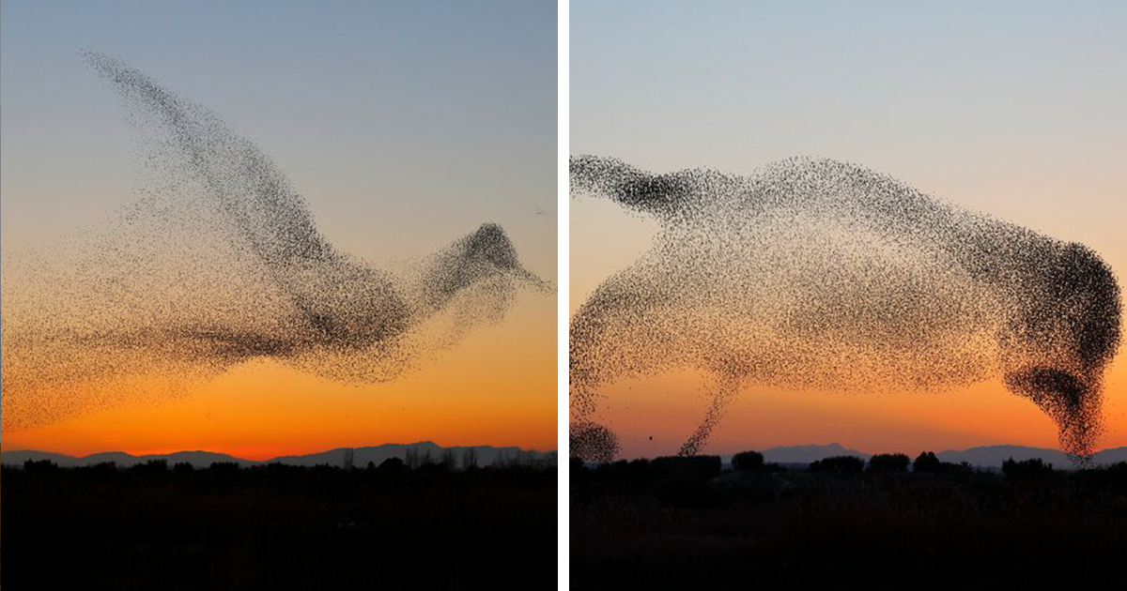
How do we choose who does the work?
The right person or people for the job
Notes:
The team decides and makes their plan to get the most work done in a given time frame. This is self-organization and is the most efficient way of distributing effort. Period.

Slide 15
Definition of “Done”
Release is a business decision
Ready to Release
Integrated
Works with Everything Else
Validated
Fit for Purpose
Code Checked In
Works on My Machine
“Done” establishes rigorous baseline for each piece of work
Notes:
As a baseline, a definition of “Done” makes transparent the work needed for all pieces of work. In the example above, the 4 work tasks must always be done regardless of the amount, complexity and risk/uncertainty in a piece of work. If these steps are ignored or applied inconsistently, story point estimates will estimate different things depending on who is doing the work.

Slide 16
The Whole Estimation Picture
Amount of Work
Risk and Uncertainty
Complexity
Definition of “Done”
Effort combines 3 estimates and is made consistent with definition of “Done”
Notes:
Benefits:
All work to deliver is included
No “hidden” work escapes the estimate; all work necessary to make something “Done” is made transparent
Develops team’s reasoning skills and estimation vocabulary
Fosters teamliness; team thinking; collaborative approach; optimize individuals’ time working.

Slide 17
How do we assign story points to the work?!
Notes:
So what’s a 1 and what’s a 13? Since this is a relative scale, you must first start by creating an anchor against which all other work will be gauged.

Slide 18
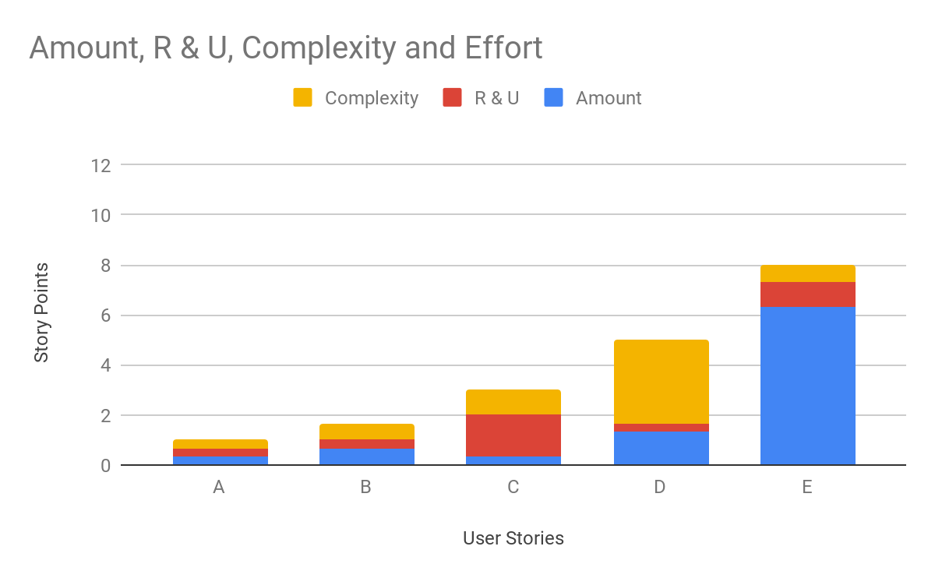
Anchor Estimates
8
5
3
1
2
Choosing the smallest allows others to be relatively gauged.
Notes:
Step 1 - pick the smallest effort work and assign it a story point value of 1.
Step 2 - use a non-linear scale like a fibonacci series to make bucketing easier.
note: we’re bad at estimating things as they grow in effort. A non-linear scale gives us effort distinction without forcing unnecessary precision of comparison

Slide 19
How to estimate this new work?
?
5
3
2
1
With points defined relatively, it becomes easier to gauge new work
Notes:
Step 3 - place work in effort buckets, constantly relating new work to those already in buckets. This provides accuracy and not precision. Accuracy is enough.
Step 4 - Profit!! Wait, I’m getting ahead of myself...

Slide 20
Yes, but when will the work be done?!
Notes:
Story points are about time. Ok, we’ve said it.

Slide 21
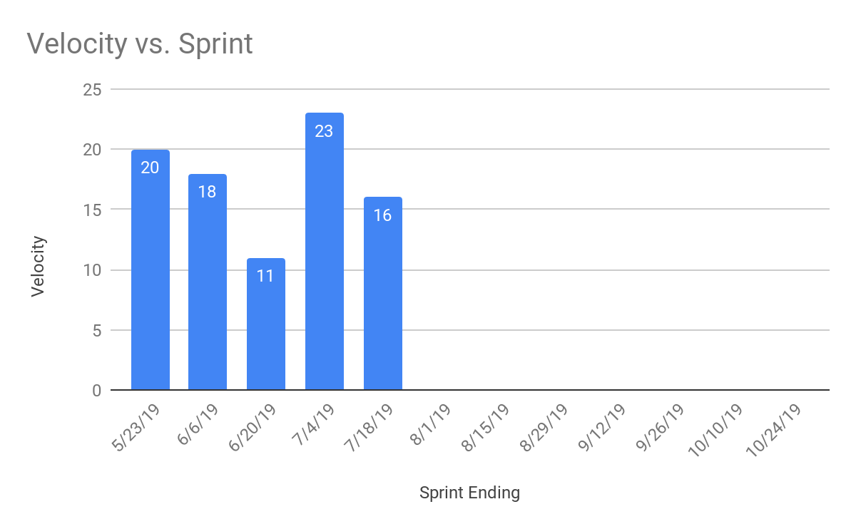
Relate team velocity to time
???
Notes:
Sum the “Done” story points of work done in a Sprint timebox. Take the most recent few Sprints; historical data gets less useful over time. Yesterday’s weather is always a better metric than last year’s. What can that tell us about the future?

Slide 22
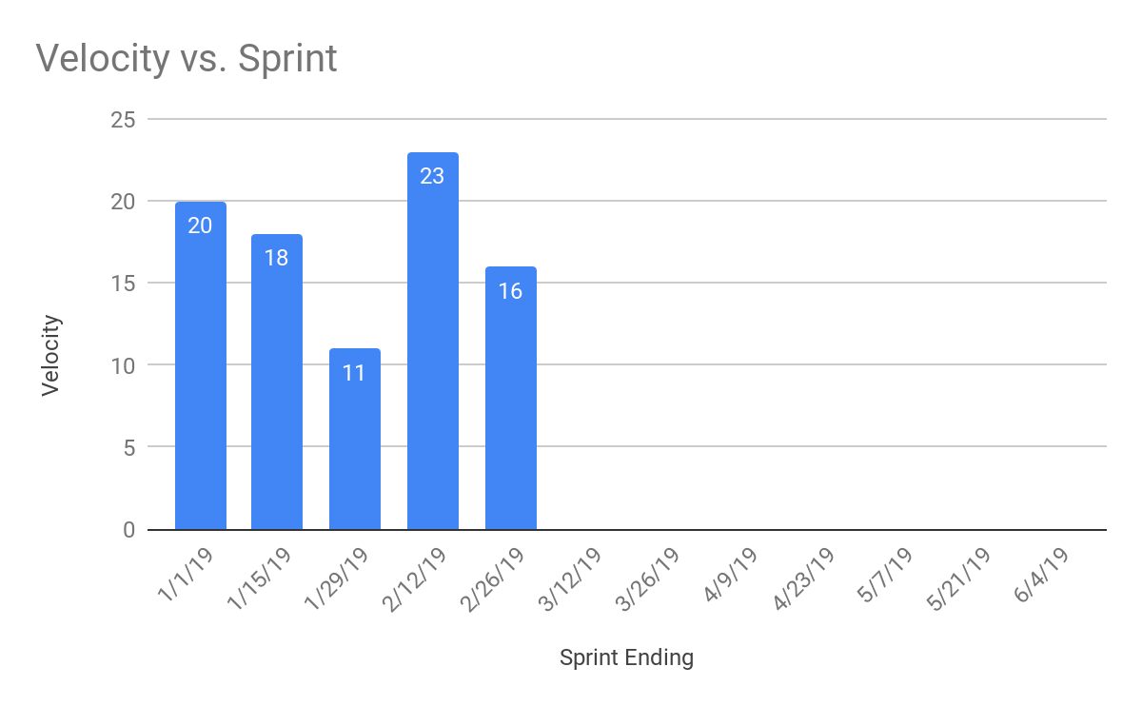
Use team velocity trends to forecast *
Max
Med.
Min
???
* forecast - a reasonable estimation of the future based on recent, empirical, trend data
Notes:
Using a the highest, recent velocity, a median average (not mean average) and the minimum, recent velocity forecasts can be made within the “cone of uncertainty.”
This is honest. This is empirical. This is USEFUL.

Slide 23
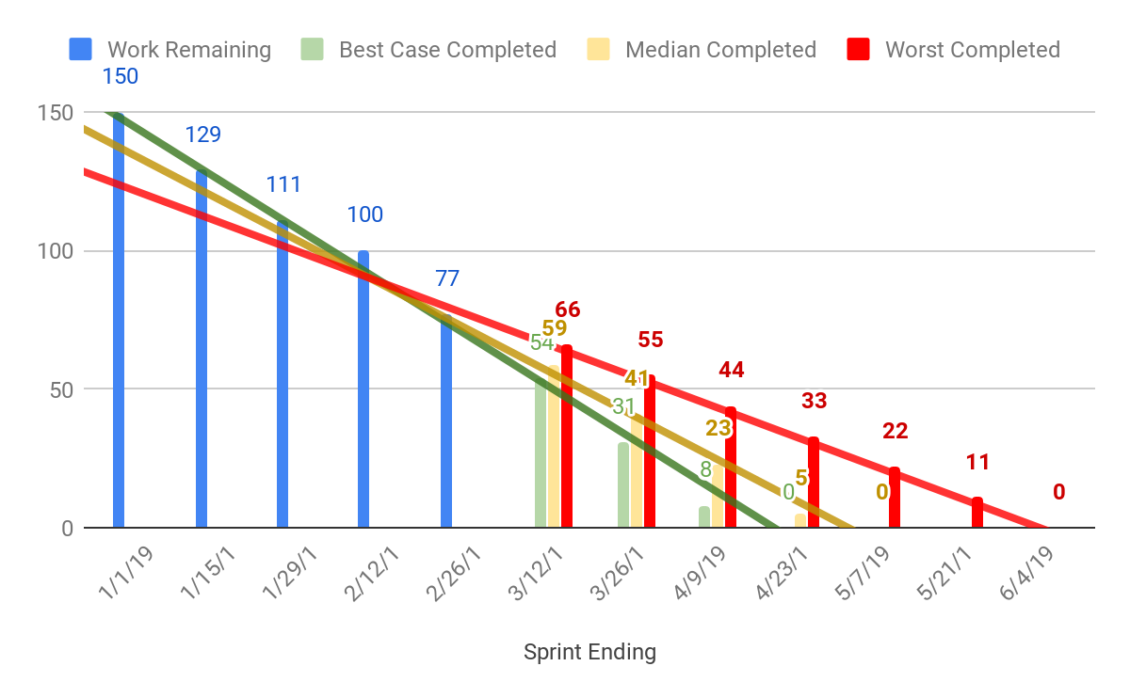
The Cone of Uncertainty
Notes:
Using a the highest, recent velocity, a median average (not mean average) and the minimum, recent velocity forecasts can be made within the “cone of uncertainty.”
This is honest. This is empirical. This is USEFULL
Takeaway: honest, statistical models (even very simply ones) offer useful hints that inform our forecast

Slide 24
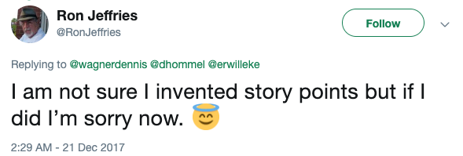
Should you use story points?

Slide 25
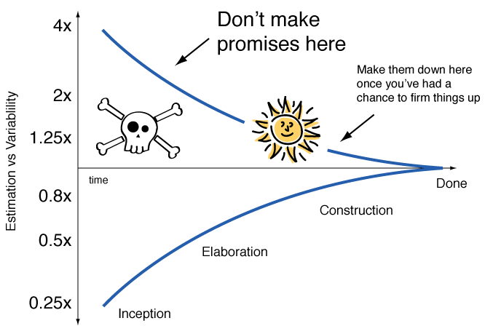
Alternatives?
Notes:
You may be pressed to give predictions or promises for a number of important, business reasons such as:
Executive strategies
Sales Goals
Account Management Concerns
Contracting & Legal Requirements
Project Management Plans

Slide 26
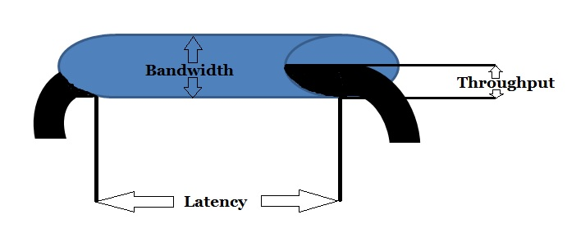
Alternatives?
Notes:
Lean Concept of Flow
Heijunka - smoothing and leveling
Thought experiment: if all the work was roughly the same size, would we still need to estimate it?

Slide 27
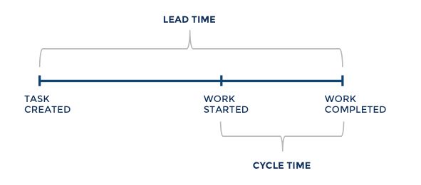
Alternatives?

Slide 28
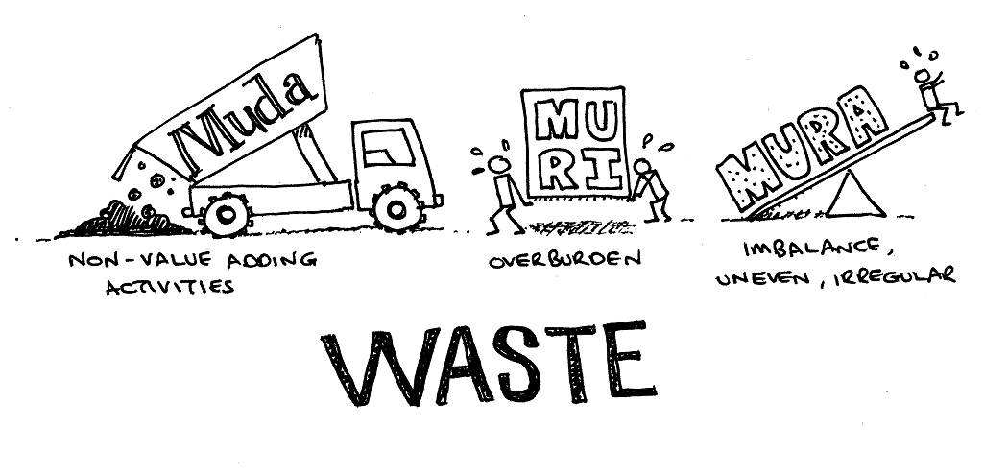
Alternatives?
“…employees are offering a very important part of their life to us.
If we don’t use their time effectively, we are wasting their lives.”
- Ejii Toyoda
Notes:
Work on the system, not the estimation
Identify and reduce waste in all its forms
Break down work into the smallest, most uniform bits you can

Slide 29
Why estimate...
when you can let the system’s flow do it for you
Notes:
Good Reasons:
You’ll understand the work more fully
You’ll develop a vocabulary for talking about the challenges in the work
You’ll forecast with increasing accuracy based on actual data that encompasses the whole amount of work
You’ll work as a team to take in, refine, complete, and deliver work with agility.
Statistical predictability of the system’s output is a more desirable heuristic than a precise estimate.

Slide 30
Articles for reference
What are Story Points?
The Main Benefit of Story Points
Story Points Estimate Effort not Just Complexity
Story Points are Still About Effort

